Slide 1






Foundations of
Quantum Information Science (QIS 102)
Dave Biersach
Brookhaven National Laboratory
dbiersach@bnl.gov
Session 09
Probability and Statistics

Slide 2
Session 09 – Part 1 of 2 – Topics
Analyze Hero ability scores in role-playing games by calculating the mean, variance, and standard deviation of a sequence of random numbers
Calculate common statistics on a set of numbers, including median and mode
The enumerate() class returns an iterable sequence of tuples, with each tuple containing both an index and the corresponding element value at that index
Understand the motivation for Bessel’s correction to the biased sample variance to develop a better estimate of the population variance

Slide 3
Session 09 – Part 1 of 2 – Topics
Develop a computational mathematics experiment that uncovers a magic number hidden in the Uniform Distribution

Slide 4

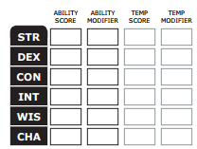
Generating Hero Ability Values
In most role-playing games, heroes have abilities such as strength, dexterity, intelligence, charism, etc.
Initial abilities are often measured in ranges like 3 – 18
At the beginning of the game, players roll dice to determine the initial values for each ability
The higher the value, the more likely the player will succeed while adventuring

Slide 5
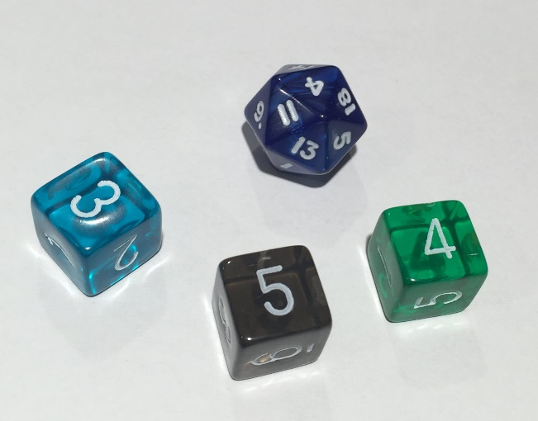
Generating Hero Ability Values
Two ways of rolling for initial abilities between 3 and 18
Roll a 20-sided die just once (1d20), but reroll if face value is 1, 2, 19, or 20
Roll a 6-sided die three times (3d6), summing the value of each roll
Using the 1d20 method is faster than 3d6, especially when having to roll for six separate abilities
17
11
15
5
7
3

Slide 6
Generating Hero Ability Values
Two ways of rolling for initial abilities between 3 and 18
Roll a 20-sided die just once (1d20), but reroll if face value is 1, 2, 19, or 20
Roll a 6-sided die three times (3d6), summing the value of each roll
Which method would you want to use? Why?
17
11
15
5
7
3

Slide 7
Mean vs. Variance
Imagine two different classes take the same test
1st period students score between 50 and 100 with μ = 75
2nd period students score between 70 and 80 with μ = 75
Variance ${(σ}^{2})$ is the average “distance” between each number in a set and the mean $\left(μ\right)$ of that set
1st period students have a greater variance in scores than 2nd period
Variance is a measure of central tendency – on average how close around the mean do all the numbers fall?
For every data point, we sum the square of the difference between the number and the mean. Then we divide that sum by the total number of data points

Slide 8
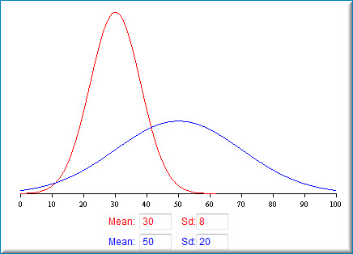
Mean vs. Standard Deviation
Note: Standard Deviation (σ) is the square root of the Variance (σ²)

Slide 9
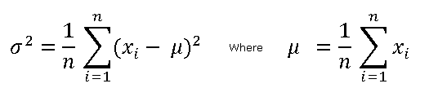
Mean, Variance, Standard Deviation
Mean
$$x=\left\{2, 9, 11, 5, 6\right\}∴n=5$$
$$\sum_{i=1}^{n}{x_{i}}=\left(2+9+11+5+6\right)=33$$
$$μ=\frac{33}{5}=6.6$$

Slide 10
Mean, Variance, Standard Deviation
Variance
Mean
$$x=\left\{2, 9, 11, 5, 6\right\}∴n=5, μ=6.6$$
$$\sum_{i=1}^{n}{{{(x}_{i}−μ)}^{2}}={(2−6.6)}^{2}+{(9−6.6)}^{2}+{(11−6.6)}^{2}+…=49.2$$
$$σ^{2}=\frac{49.2}{5}=9.84$$

Slide 11
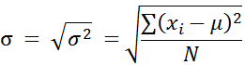
Mean, Variance, Standard Deviation
Variance
Mean
$$x=\{2, 9, 11, 5, 6\}$$
Standard Deviation
$$σ^{2}=9.84$$
By taking square root of variance, the standard deviation has the same units as the source data
$$σ=\sqrt{9.84}≅3.13$$

Slide 12
Determine Which Roll Method is Best
Consider a program to generate 1,000,000 hero ability scores, comparing the mean and standard deviation of the 1d20 versus the 3d6 dice roll methods
Which dice roll method would you want to use to generate your hero’s abilities – and why?

Slide 13
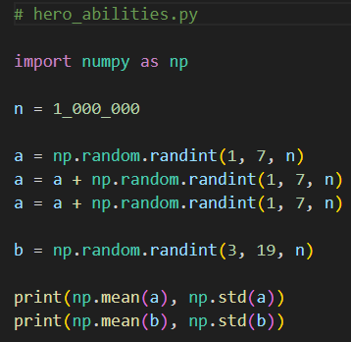
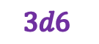
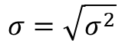
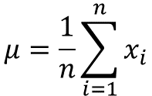
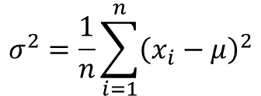
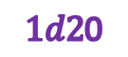
Open hero_abilities.py
①
②
$$3d6$$
③
④
$1d2$0
⑤
⑥
$$μ=\frac{1}{n}\sum_{i=1}^{n}{x_{i}}$$
$$σ^{2}=\frac{1}{n}\sum_{i=1}^{n}{{\left(x_{i}−μ\right)}^{2}}$$
$$σ=\sqrt{σ^{2}}$$

Slide 14
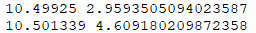
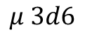
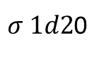
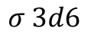
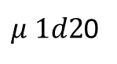
Run hero_abilities.py
$$μ 3d6$$
$$σ 3d6$$
$μ 1d2$0
$σ 1d2$0
Which roll type will most likely give you the highest average score across all abilities?

Slide 15
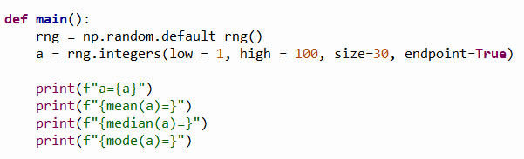
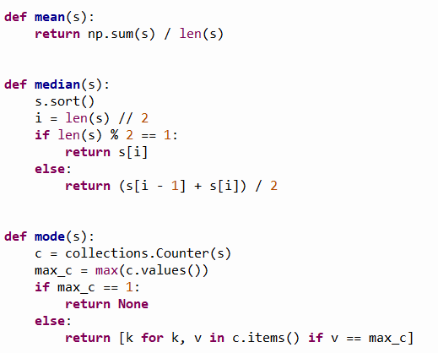
Open common_statistics.py
①
②
[1, 100]
inclusive, inclusive
③
⑤
④
⑥
⑦
⑧
⑨
⑩

Slide 16
View common_statistics.py
①
②
③
④
⑤

Slide 17
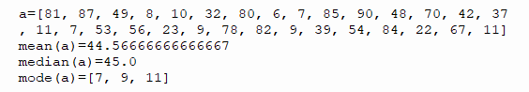
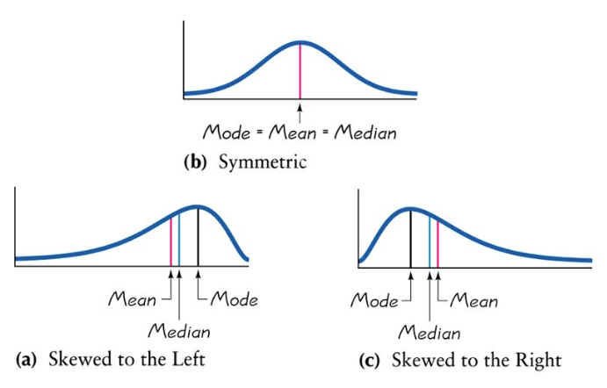
Run common_statistics.py
①
②
③
MULTI-MODAL
Your numbers will not match these, and you will get different numbers every time you run the program because we generate a random array without using any seed number

Slide 18
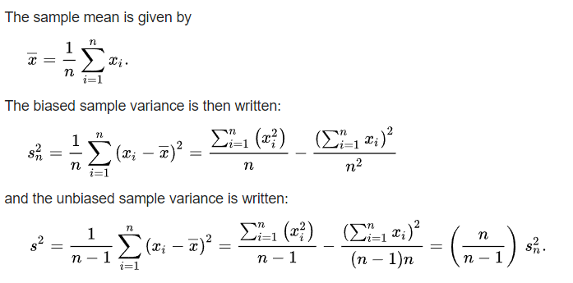
Bessel’s Correction
BSV

Slide 19
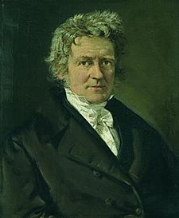
Bessel’s Correction
What is the difference between population vs. sample variance?
Fredrich Wilhelm Bessel (1784-1846)
BSV
UBSV
Bessel’s Correction
(UBSV)
Does subtracting 1 from n really
make any difference at all?

Slide 20
Bessel's Correction
Write an experimental simulation in Python that generates a full population set containing 7000 random natural numbers < 1000
Calculate the population variance (PV) for that full set
Create 20,000 random samples of size n taken from that full population set. Find the mean biased sample variance (BSV) for all 20,000 of those sample sets
Create 20,000 random sample sets of size 2. Then find the mean BSV for all 20,000 of those two-sample sets
Create 20,000 random sample sets of size 3. Then find the mean BSV for all 20,000 of those three-sample sets
Do this for all samples sets up to size 20

Slide 21
Bessel's Correction
Display a table with one row for each of the sample sizes from 2 to 20 with columns showing the sample size, the mean BSV, the true population variance (PV), and ratio of BSV/PV
Row #1 represents the statistics if you only created samples containing two random samples from the population
Row #2 represents the statistics if you only created samples containing three random samples from the population
Plot the ratio of BSV/PV for increasing sample sizes from 2 to 20, and superimpose a plot of the hyperbola (n-1)/n
How does the graph of BSV/PV compare to that hyperbola?
We can rarely calculate the true PV – but can we reliably use the BSV with small sample sets to estimate the true PV?

Slide 22
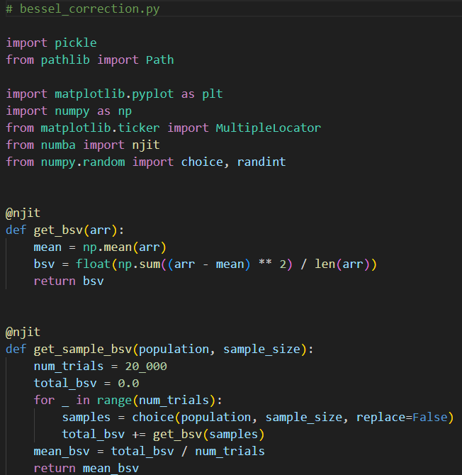
Open bessel_correction.py
①
②
③
④
⑤
⑥
⑦

Slide 23
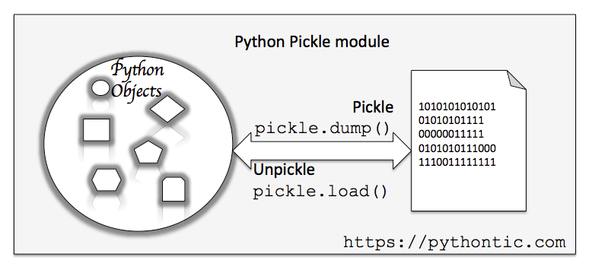
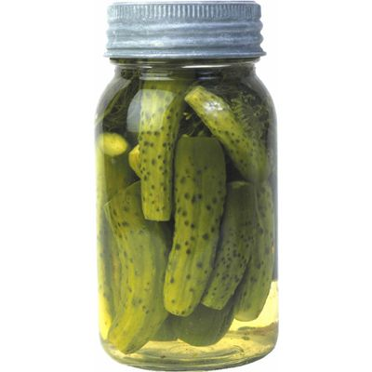
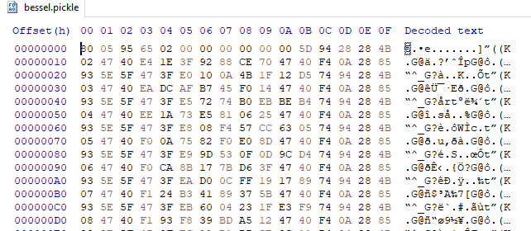
Python Pickle

Slide 24
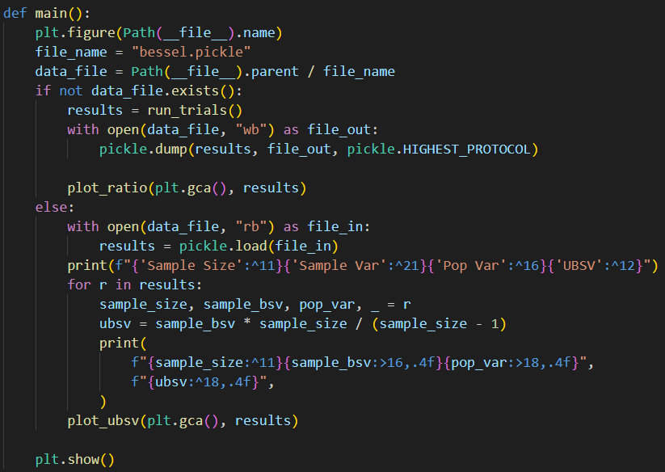
View bessel_correction.py
①
②
③
④
⑤
⑥
⑦

Slide 25
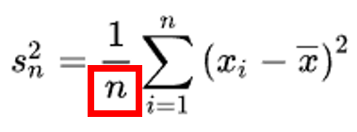
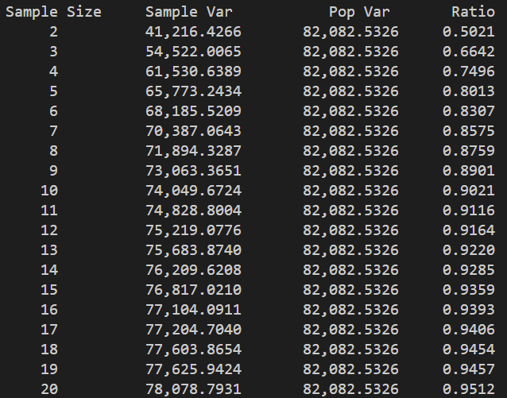
Run bessel_correction.py
Biased (uncorrected) sample variance (BSV)
True population variance (PV)
BSV / PV
Sample sets of size n, drawn from the full population set of 7000 random natural numbers all < 1000

Slide 26
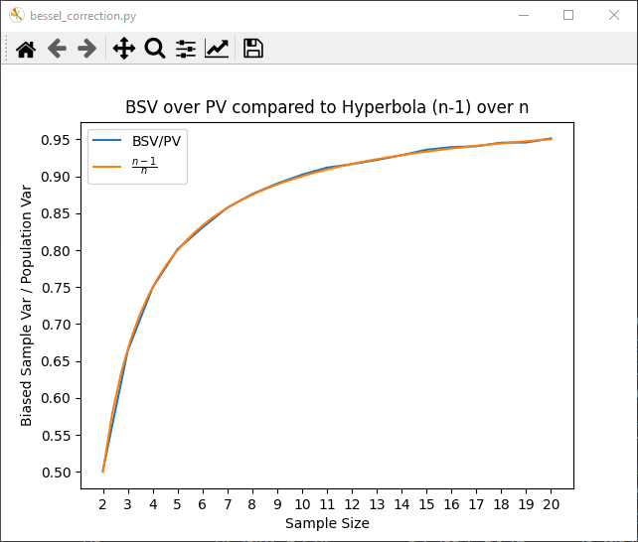
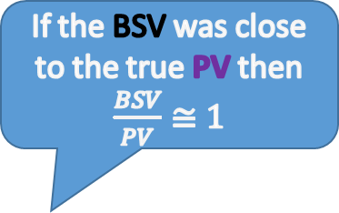
Bessel's Correction
If the BSV was close to the true PV then $\frac{BSV}{PV}≅1$
At small sample sizes, the BSV is a poor estimator for the true PV
(B)iased = BAD!

Slide 27
Bessel's Correction
Recall, we know n and the BSV for each sample set, but we don’t know the true PV
The ratio of BSV/PV tracks very closely to the hyperbola y=(n-1)/n

Slide 28
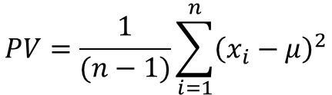
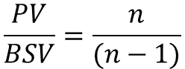
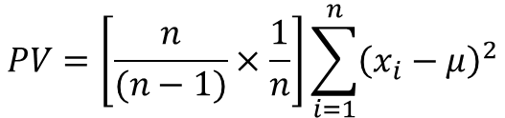
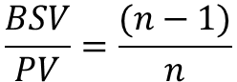
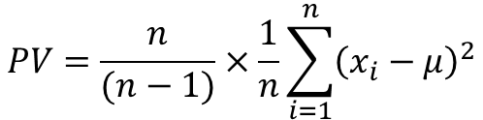
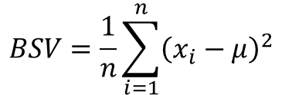
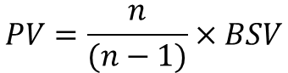
Bessel's Correction
$$\frac{BSV}{PV}=\frac{(n−1)}{n}$$
$$PV=\frac{n}{(n−1)}×\frac{1}{n}\sum_{i=1}^{n}{{\left(x_{i}−μ\right)}^{2}}$$
$$\frac{PV}{BSV}=\frac{n}{(n−1)}$$
$$PV=\left[\frac{n}{(n−1)}×\frac{1}{n}\right]\sum_{i=1}^{n}{{\left(x_{i}−μ\right)}^{2}}$$
$$PV=\frac{n}{(n−1)}×BSV$$
$$BSV=\frac{1}{n}\sum_{i=1}^{n}{{\left(x_{i}−μ\right)}^{2}}$$
$$PV=\frac{1}{(n−1)}\sum_{i=1}^{n}{{\left(x_{i}−μ\right)}^{2}}$$
UBSV
Bessel’s Correction
Subtracting 1 from n does make a difference!
If we can only take a small sample size, the UBSV will give a better estimate of the actual population variance!

Slide 29
View bessel_correction.py
①
②
③
④
⑤
⑥
⑦
⑧
⑨

Slide 30
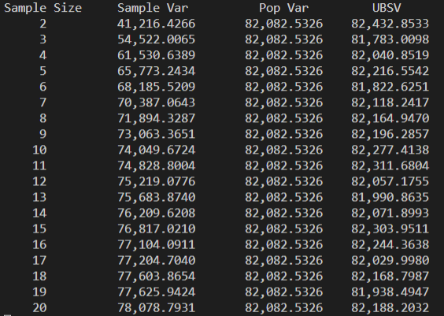
Run bessel_correction.py AGAIN
Even with small sample sizes, the UBSV can give a good estimate of the full population variance!
Consider here we are sampling only 0.24% (17/7000) of the population!

Slide 31
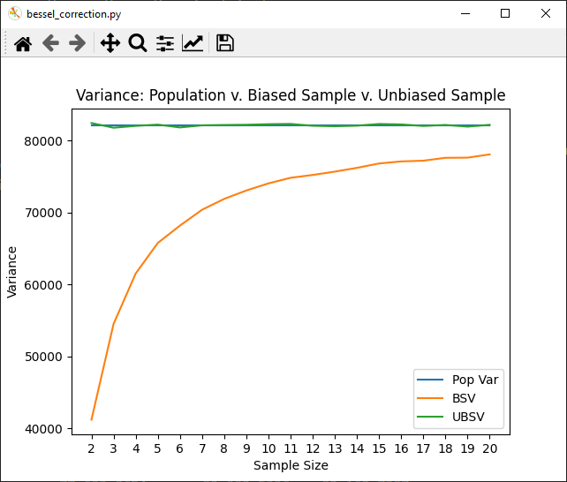
Bessel's Correction
At small sample sizes, the BSV is a poor estimator for the true PV

Slide 32
Bessel's Correction
However, the UBSV tracks very closely to the true PV, even with small sample sizes
Fredrich Wilhelm Bessel (1784-1846)

Slide 33
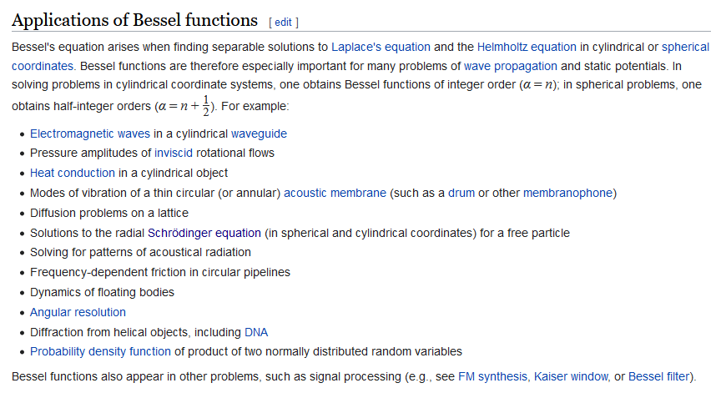
Bessel Functions

Slide 34
Variance of the Uniform Distribution
Your scientist needs a program that can:
Generate 15 sets of uniformly distributed random numbers where each set has a random size between [10,000…200,000) items
The lower limit for each item in a set is a random integer between 0 and 10,000 (inclusive, exclusive)
The upper limit for each item is that set’s lower limit plus another random integer between 0 and 100,000 (inclusive, exclusive)
Within each set, every item is a random float chosen within a range [lower limit…upper limit] (inclusive, inclusive)
Calculate the mean (μ) and variance (σ²) for each set's population
$$σ^{2}=\frac{1}{n}\sum_{i=i}^{n}{{\left(x_{i}−μ\right)}^{2} where μ=\frac{1}{n}\sum_{i=1}^{n}{x_{i}}}$$

Slide 35
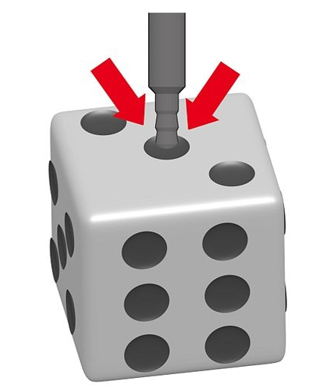
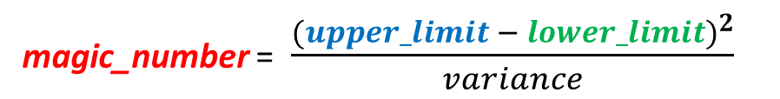
Variance of the Uniform Distribution
Your assignment is to discover a magic number hidden in all continuous uniform random number distributions
Calculate and display this “constant” for each set:
Is this number the same for ALL uniform distributions?
Can we use this value to test if dice are loaded?
magic_number = $\frac{{(upper_limit − lower_limit)}^{2}}{variance}$

Slide 36
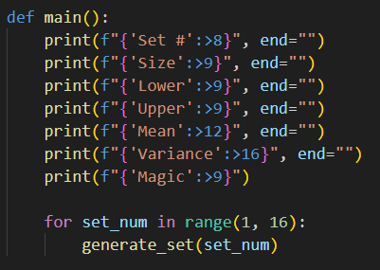
Open uniform_variance.py
①
②
③
④
⑤
⑥
⑦

Slide 37
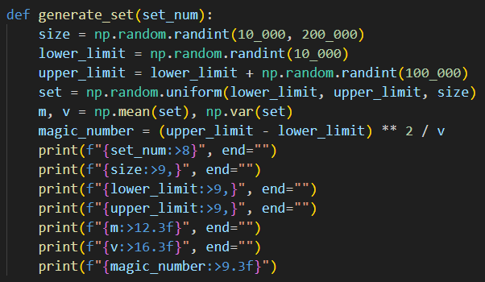
View uniform_variance.py
①
②
③
④
⑤
⑥
⑦
⑧
⑨

Slide 38
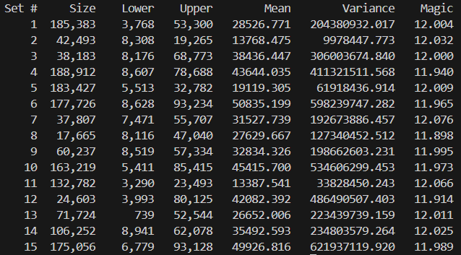
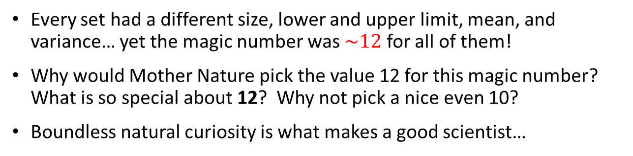
Run uniform_variance.py
Every set had a different size, lower and upper limit, mean, and variance… yet the magic number was $\sim 12$ for all of them!
Why would Mother Nature pick the value 12 for this magic number? What is so special about 12? Why not pick a nice even 10?
Boundless natural curiosity is what makes a good scientist…

Slide 39
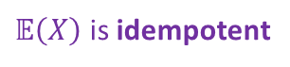
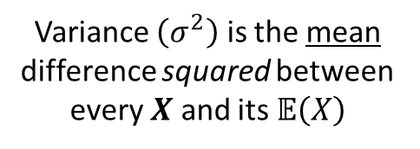
Variance of the Uniform Distribution
$$σ^{2}=\frac{1}{n}\sum_{i=i}^{n}{{\left(x_{i}−μ\right)}^{2} where μ=\frac{1}{n}\sum_{i=1}^{n}{x_{i}}}$$
The expected value $\left(𝔼\right)$
of a random variable $X$ is its mean value $\left(μ\right)$
Variance $\left(σ^{2}\right)$ is the mean difference squared between every $X$ and its $𝔼\left(X\right)$
$$𝔼\left(X\right)=μ=\frac{1}{n}\sum_{i=1}^{n}{x_{i}}$$
$σ^{2}=𝔼$ $\left[{\left(X−𝔼\left(X\right)\right)}^{2}\right]$
The expected value $\left(𝔼\right)$
returns a constant value
$$𝔼\left(X\right)=μ$$
$$𝔼\left(𝔼\left(X\right)\right)=𝔼\left(X\right)$$
The expected value $\left(𝔼\right)$
of a constant value returns that same value
$$𝔼\left(𝔼\left(𝔼\left(X\right)\right)\right)=𝔼\left(X\right)$$
$$𝔼\left(μ\right)=μ$$
$𝔼\left(X\right)$ is idempotent

Slide 40

Variance of the Uniform Distribution
$$σ^{2}=\frac{1}{n}\sum_{i=i}^{n}{{\left(x_{i}−μ\right)}^{2} where μ=\frac{1}{n}\sum_{i=1}^{n}{x_{i}}}$$
$$μ=𝔼\left(X\right)=\frac{1}{n}\sum_{i=1}^{n}{x_{i}}$$
$σ^{2}=𝔼$ $\left[{\left(X−𝔼\left(X\right)\right)}^{2}\right]$
FOIL
$$σ^{2}=𝔼\left[X^{2}−2X𝔼\left(X\right)+{𝔼\left(X\right)}^{2}\right]$$
$σ^{2}=𝔼$ $\left[{\left(X−𝔼\left(X\right)\right)}^{2}\right]$
Note: $𝔼\left(x\right)$ is a distributive linear operator
$$𝔼\left(μ\right)=μ$$
$$σ^{2}=𝔼\left(X^{2}\right)−𝔼\left(2X𝔼\left(X\right)\right)+𝔼\left({𝔼\left(X\right)}^{2}\right)$$
$$𝔼\left(𝔼\left(X\right)\right)=𝔼\left(X\right)$$
$$σ^{2}=𝔼\left(X^{2}\right)−2𝔼\left(X\right)𝔼\left(X\right)+{𝔼\left(X\right)}^{2}$$
Faster because
only one subtraction is required!
$$σ^{2}=\left(\frac{1}{n}\sum_{i=1}^{n}{x_{i}^{2}}\right)−μ^{2}$$
$$σ^{2}=𝔼\left(X^{2}\right)−2{𝔼\left(X\right)}^{2}+{𝔼\left(X\right)}^{2}$$
$$σ^{2}=𝔼\left(X^{2}\right)−{𝔼\left(X\right)}^{2}$$
$$σ^{2}=𝔼\left(X^{2}\right)−μ^{2}$$

Slide 41
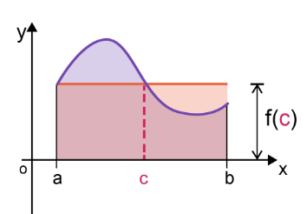
Variance of the Uniform Distribution
$f\left(c\right)=$ the average value of the function
Mean Value Theorem (Integrals)
$${Area}_{red}={Area}_{curve}$$
$${Area}_{red}=f(c)×\left(b−a\right)$$
$${Area}_{curve}=\int_{a}^{b}{f\left(x\right)ⅆx}$$
$$f\left(c\right)×\left(b−a\right)=\int_{a}^{b}{f\left(x\right)ⅆx}$$
Random Variable (Uniform Distribution)
$$𝔼\left(X\right)=\frac{1}{n}\sum_{i=1}^{n}{x_{i}}$$
$$f\left(c\right)=\frac{1}{\left(b−a\right)}\int_{a}^{b}{f\left(x\right)ⅆx}$$
Discrete:
$$𝔼\left(X\right)=\frac{1}{\left(b−a\right)}\int_{a}^{b}{xⅆx}$$
$$f\left(c\right)=μ=𝔼\left(X\right)$$
Continuous:

Slide 42







Variance of the Uniform Distribution
$$𝔼\left(X\right)=\frac{1}{\left(b−a\right)}\int_{a}^{b}{xⅆx}$$
Moment Generating Functions
$$𝔼\left(X^{2}\right)=\frac{1}{\left(b−a\right)}\int_{a}^{b}{x^{2}ⅆx}$$
$$σ^{2}=𝔼\left(X^{2}\right)−μ^{2}$$
$$μ=\frac{1}{b−a}\int_{a}^{b}{xⅆx}=\frac{1}{b−a}\left({\left.\frac{x^{2}}{2}\right|}_{a}^{b}\right)=\frac{b+a}{2}$$
Hero Ability Results
$$𝔼\left(X^{2}\right)=\frac{1}{b−a}\int_{a}^{b}{x^{2}ⅆx}=\frac{1}{b−a}\left({\left.\frac{x^{3}}{3}\right|}_{a}^{b}\right)=\frac{b^{2}+ab+a^{2}}{3}$$
$$\frac{\left(18+3\right)}{2}=10.5$$

Slide 43


Variance of the Uniform Distribution
$$𝔼\left(X\right)=\frac{1}{\left(b−a\right)}\int_{a}^{b}{xⅆx}$$
Moment Generating Functions
$$𝔼\left(X^{2}\right)=\frac{1}{\left(b−a\right)}\int_{a}^{b}{x^{2}ⅆx}$$
$$12= \frac{{(upper_limit − lower_limit)}^{2}}{variance}$$
$$σ^{2}=𝔼\left(X^{2}\right)−μ^{2}$$
$$μ=\frac{1}{b−a}\int_{a}^{b}{xⅆx}=\frac{1}{b−a}\left({\left.\frac{x^{2}}{2}\right|}_{a}^{b}\right)=\frac{b+a}{2}$$
This is the second central moment of a continuous
uniform distribution
$$𝔼\left(X^{2}\right)=\frac{1}{b−a}\int_{a}^{b}{x^{2}ⅆx}=\frac{1}{b−a}\left({\left.\frac{x^{3}}{3}\right|}_{a}^{b}\right)=\frac{b^{2}+ab+a^{2}}{3}$$
$$σ^{2}=𝔼\left(X^{2}\right)−μ^{2}=\frac{b^{2}+ab+a^{2}}{3}−{\left(\frac{b+a}{2}\right)}^{2}=\frac{{\left(b−a\right)}^{2}}{12}$$
Variance

Slide 44

Variance of the Uniform Distribution
The statistics of many probability distributions vary greatly depending if you are using continuous or discrete sampling
In the prior lab, we selected floating point numbers from a continuous uniform distribution because we called np.random.uniform()
However, this does not realistically model rolling dice, where each side has a distinct integer value, so we must use a discrete uniform distribution and call np.random.randint()
When we change the type of distribution, we must also change our expression for $σ^{2}$ because that magic number 12 must still hold for any uniform distribution!

Slide 45

Open second_moment.py
②
①
③
④
⑤
⑥
⑦
⑧
⑨
⑩

Slide 46

Run second_moment.py
The magic number is supposed to be 12 for all uniform distributions!

Slide 47





Variance of the Uniform Distribution
For a discrete uniform distribution, the second moment (variance) is given by this formula:
For a die, the lower limit is always $a=1,$ and the upper limit $b=$ the number of sides of the die
Substituting $a=1$ and rearranging the formula yields:
We must modify the program second_moment.py to incorporate this different formula for the discrete variance
Continuous
$$σ^{2}=\frac{{\left(b−a+1\right)}^{2}−1}{12}$$
$$σ^{2}=\frac{{\left(b−a\right)}^{2}}{12}$$
$$12=\frac{b^{2}−1}{σ^{2}}$$
$$12=\frac{{\left(b−1\right)}^{2}}{σ^{2}}$$

Slide 48

Edit second_moment.py
①

Slide 49

Run second_moment.py
The magic number is supposed to be 12 for all uniform distributions!

Slide 50


Variance of the Uniform Distribution
The two principal questions are: why and how?
Why are the variances different?
How do we derive the formula for the variance of a discrete uniform distribution?
Hint: Gaussian Summation Formula for the Squares of the Natural Numbers ☺
https://proofwiki.org/wiki/Variance_of_Discrete_Uniform_Distribution
$$σ^{2}=\frac{{\left(b−a\right)}^{2}}{12}$$
$$σ^{2}=\frac{{\left(b−a+1\right)}^{2}−1}{12}$$
Continuous
Discrete

Slide 51
Session 09 – Part 2 of 2 – Topics
Appreciate the Binomial Distribution as the discrete probability taken from independent Bernoulli trials
Investigate if a Normal Distribution can be generated from a Uniform Distribution using a Pachinko game
Demonstrate the Birthday Paradox by calculating the probability that two students within a class share the same birthday as we increase the class size
Consider an approach to "measuring" randomness by comparing different methods of shuffling a deck of cards
Analyze the accuracy of the Lattice Point count estimate suggested by Gauss for the Circle Problem

Slide 52




Binomial Distribution
The binomial distribution with parameters $n$ and $p$ is the discrete probability distribution of the number of successes in a sequence of $n$ independent Bernoulli trials
Each trial asks a yes/no question with Boolean-valued outcome: success (with probability $p$) or failure (with probability $q=1−p$)
Bernoulli showed in his Ars Conjectandi that the probability of getting exactly $k$ successes in $n$ independent Bernoulli trials is given by the probability mass function (PMF):
$$Pr\left(X=k\right)=\left({n \atop k}\right)p^{k}q^{n−k}$$
Christiaan Huygens
(1629-1695)
Jacob Bernoulli
(1655-1705)

Slide 53

Open binomial_distribution.py
①
②
③
④
⑤
⑥
⑦
⑧
⑨

Slide 54

Run binomial_distribution.py
If this represents a 90% success rate, why is there such a low chance of getting five successes?

Slide 55

Simulating a Normal Distribution
Until recently, most computer languages only provided a uniform pseudo-random number generator
Growing up, I had heard of a bell curve, and I understood the rationale for curving test scores
However, I could not create a Normal distribution using my 1980 vintage TRS-80 computer using Bill Gates’ first BASIC language interpreter
… or could I?

Slide 56

Simulating a Normal Distribution
68.26% (34.13% x 2) of all values following a normal distribution should fall within $±1σ$ from the $μ$

Slide 57

Simulating a Normal Distribution
There are several ways to turn a uniform distribution into a Normal distribution
However, developing an accurate functional approximation to a Normal curve requires advanced mathematics
Consider the following code by Abramowitz & Stegun…
1972

Slide 58

Simulating a Normal Distribution
This was neat, but I did not understand it at all!
Where did all those magic numbers come from?
I was a high school senior – I wanted to base my approach on something tangible

Slide 59

The Pachinko Distribution

Slide 60

The Pachinko Distribution

Slide 61
Simulating a Normal Distribution
We can simulate dropping balls down a Pachinko machine where at each level a ball can move one step to left or right
If we drop enough balls through enough levels, and we accumulate the count of balls in each slot at the bottom, then we should be able to simulate a normal distribution
We will visually (qualitatively) judge how well this method approximates a Normal distribution
However, there are many statistical (quantitative) methods to calculate if an algorithm emits a distribution that has a reasonable deviation from the perfect (pure) Normal distribution
If the discrepancies are statistically significant, then we cannot trust that our algorithm is producing a “good enough” Normal distribution to use in scientific simulations

Slide 62
Simulating a Pachinko Machine
6 levels
Slot #:

Slide 63

Open pachinko_normal.py
6 levels
Slot #:
-3
-2
-1
0
1
2
3
A “ball" is just the slot # (-3 to 3) where it landed
①
②
Python Ternary Operator
③
④
⑤

Slide 64


View pachinko_normal.py
①
②
③
④
⑤
⑥
balls[ball_num]
⑦
⑧
⑨

Slide 65

Run pachinko_normal.py
Using these two parameter values does not generate a "good" Normal distribution

Slide 66

Edit pachinko_normal.py
What if we increase 10x the number of pachinko balls dropped through the machine?

Slide 67

Run pachinko_normal.py
Better, but there are still significant gaps between observed vs. expected values

Slide 68

Edit & Run pachinko_normal.py
Increase the number of balls by another 10x
(edit line 26 and set num_balls = 100_000)
Increase the number of levels 2x
(edit line 27 and set num_levels = 20)

Slide 69

Edit & Run pachinko_normal.py
Increase the number of balls by another 10x
(edit line 26 and set num_balls = 1_000_000)
Increase the number of levels 2x
(edit line 27 and set num_levels = 40)
Still getting some gaps in the slots with the highest probability

Slide 70

Edit & Run pachinko_normal.py
Finally, around 80 million bounces, we start to faithfully approximate a Normal distribution
Increase the number of levels 2x
(edit line 27 and set num_levels = 80)

Slide 71
Simulating a Normal Distribution
The Pachinko model can accurately mimic a Normal distribution - but only under the right circumstances!
We found that it is not just the number of balls that are used in the experiment that matters, but also the number of levels in the simulated Pachinko board
The levels affect how wide (displacement from the center slot) a ball can fall (left or right) from the topmost (first) pin
We must use enough levels (therefore creating sufficient width at the last level) to ensure the balls spread out during their fall to occupy those bottom slots that represent the higher sigma values of a Normal distribution

Slide 72

Simulating a Normal Distribution
https://en.wikipedia.org/wiki/Bean_machine

Slide 73



Central Limit Theorem
In quantum mechanics, position and momentum are Fourier transforms of each other, and the Gaussian Normal is the only function which is its own Fourier transform! $†$

Slide 74

Simulating a Normal Distribution
Python's SciPy.stats uses the code from Abramowitz & Stegun and therefore needs only one function call to generate a normally distributed random variable vs. my 80M iteration Pachinko method ☺

Slide 75

Testing for Gaussian Distribution
The SciPy package provides several credible quantitative distribution “fit” tests that stand up to peer review
Shapiro-Wilk : can be sensitive to sample size
D'Agostino K² : considers skew (asymmetry) and kurtosis (tail density)
Anderson-Darling : improved Kolmogorov-Smirnov test
Most statistical tests return two values
The Statistic : compare this value to the critical values associated with the intended distribution
The "p-Value" : used to interpret the test – If$p≤α$ then we reject the null hypothesis $H_{0}$ meaning the sample data does not fit the distribution

Slide 76

Birthday Paradox
Given a class size of n students, write a program to calculate the probability that at least two students in that class share the same birthday
Your code should calculate this probability for 10,000 classes, each between 2 and 80 students inclusive
Assume there is only 365 days in a year (no leap years)
What is the minimum required class size to have > 50% probability of two similar birthdays?

Slide 77

Open birthday_paradox.py
①
②
③
④
⑤
⑥
⑦

Slide 78
Open birthday_paradox.py
①
②
③
④
⑤
⑥
⑦

Slide 79

View birthday_paradox.py
Indexes that passed filter
First index that passed
①
②
③
④
⑤
⑥
⑦
⑧

Slide 80

Run birthday_paradox.py
②
③
①

Slide 81
Shuffle Scorer
People who can’t “riffle” shuffle a deck of cards often spread out the cards on the table and stir them up in what is called a “wash” shuffle
Determine which is a more effective method to shuffle a deck of cards – wash or ripple shuffle
Most people think a riffle shuffle is better than a wash shuffle
Develop a statistic to measure the randomness of a card deck shuffle

Slide 82
How do we simulate shuffling?
The “wash” shuffle is essentially spreading out all the cards and moving them all around from their starting point
It is like the fast card dealer algorithm we studied
It typically takes a long time to regather the cards
The “riffle” shuffle is a fast and impressive feat
Split the deck in half
Take a “chunk” of cards from the left half, then it overlays a chunk of cards from the right half, and so on
We found the number of cards in a chunk ranged randomly between 1 - 4 cards in actual practice

Slide 83

The “Wash” (or Toddler) Shuffle
Spread out all the cards on the table. Stir the pile randomly around
several times, mixing the layers and separating any large clumps of cards.

Slide 84


The “Riffle” Shuffle
Cut the deck, then bend each half slightly upward from the middle,
letting the corners interweave as you snap the halves back together.

Slide 85
Measuring Deck Randomness
In any card game, such as Poker, Rummy, Crazy-8s, or Spades, any deal that gives one player a lot of cards with the same suit, or with the same rank, or with many partial runs, is probably not a random deck
It may not have been shuffled enough times after the previous game

Slide 86
Measuring Deck Randomness
If you start with a perfectly ordered deck, and shuffle it by some process before dealing it out to all players, then if the shuffle is good, the hands should be random
If the hands are not very random, then the shuffle was not very effective
What metrics can we devise to measure the randomness of a deal and therefore determine which shuffle is better?

Slide 87

Measuring Deck Randomness
To measure the randomness of a deck, count the cards in each hand using different metrics and add up the total score
A deck with a high score is not very random
For example, every hand in a four-person deal should get about 3.25 cards of each suit $\left({=13}/4\right)$
So, after a deal, if two players each get 12 cards in a suit, then that deck was probably not shuffled very well
We must analyze each hand individually after the deal is done to truly measure how good a shuffle process is at mixing up the cards

Slide 93

Deck Scoring
Suit
In a good random deck, there should be on average about 3.25 cards in same suit per hand if dealing four hands $\left({=13}/4\right)$
Score += (Observed – Expected)²
Rank
In a good random deck, there should be about one (1) of each rank in each hand (if dealing four hands)
If you get a hand with four of a kind, that deck was probably not very random
Score += (Observed – Expected)²

Slide 94

Open shuffle_scorer.py
③
④
⑤
⑥
⑦
①
②
⑧
In Python, like most functional languages, functions themselves are first-class citizens and can be passed as function parameters (curried)

Slide 95

View shuffle_scorer.py
①
②
③
④
⑤
⑥
⑦
⑧
⑨
⑩

Slide 96


View shuffle_scorer.py
A 3D Matrix
$$\left(4×4×13\right)$$
①
②
③
④
⑤
⑥
⑦
⑧
⑨
⑩

Slide 97



Run shuffle_scorer.py
Don't make too much fun of this!
Make sure you cut the deck first!

Slide 98
Enhanced Deck Scoring
Straight
In a good random deck, after dealing four hands, no hand should have runs of cards with consecutive (or nearly consecutive) increasing rank
A run of 7-8-9-10 is less random than 7-8-9-Q but neither are very likely
The average gap between successive ranks should be about equal to 4 if dealing four hands from a random deck
Score += (Observed-Expected)²

Slide 99
Enhanced Deck Scoring
Straight Flush
Cards in same suit with increasing rank
A run of cards with consecutive rank, all of the same suit, is extremely unlikely if the shuffle was good
The score for having this appear in any hand after a deal should dramatically increase the randomness score
Remember, the higher the randomness score, the worse the shuffle was (a higher score is considered a penalty)
Score += (Observed-Expected)⁴

Slide 100




Slide 101



Gauss' Circle Problem
Count all the lattice points (integer coordinates) within a circle of a given radius
Gauss suggested the number of lattice points is bounded by this expression, where $r$ is radius of the circle:
$$N\left(r\right)=πr^{2}+E(r)$$
and
$$\left|E(r)\right|≤2\sqrt{2πr}$$
Compare the actual number of lattice points versus Gauss' estimate, for circles having radius 1,000 to 10,000 (inclusive) in steps of 1000, and calculate the % relative error in the estimate for each circle

Slide 102



Open lattice_circle.py
③
④
⑤
⑥
①
②
⑦
⑧
⑨

Slide 103



Run lattice_circle.py
The % relative error is diminishing
JULY
2015
Carl Friedrich Gauss
(1777 – 1855)

Slide 104
Understanding Probability
The probability of a continuous random variable having an exact value is zero!!
We can never measure continuous distributions exactly
The measurement changes as we increase magnification/precision
Accumulating statistics may enable accurate trend prediction
Single events may happen in a non-deterministic manner
Yet the aggregate ensemble behavior might be deterministic
A paradox? Think Lotto: small odds for all, yet someone always wins
Scientific observables are governed by averages
Statistical Mechanics: temperate = average kinetic energy
Quantum Mechanics: Shape of electron orbitals

Slide 105
What Should Students Learn?
The Probability and Statistics Used Most Often at BNL:
Uniform, Normal, Exponential, Logarithmic
Student’s t
Bernoulli, Binomial, Beta
Poisson, Erlang, Pareto
Mean, Mode, Median
Skew, Variance, Std. Dev
Moments of Distribution
Conditional Probability
Bayesian Inference
Gamma, Chi-Squared
Maxwell-Boltzmann
Regression Techniques
Confidence Intervals
Hypothesis Testing
Time Series Analysis
ANOVA
Stochastic Processes
Markov Chains
Clustering Algorithms

Slide 106
Session 09 – Now You Know…
The mean of a set is often not enough of a meaningful statistic to describe the shape of the distribution – variance is a measure of central tendency
All random variable distributions have a 1st and 2nd moment which describes the long-term behavior of those random numbers
A perfect Normal distribution ensures that 68.26% of all values fall within one (1) standard deviation from the mean
99.73% of all values in a perfect normal distribution are within three (3) standard deviations from the mean
The normal distribution is known as the “bell curve”

Slide 107

Session 09 – Now You Know…
There are several ways to convert a uniform distribution created by a PRNG into a normal distribution – but don’t use Biersach's Pachinko method ☺
Tests like Pearson's chi-squared indicate if the discrepancies between the observed and the expected values are statistically significant
The number of lattice points within a circle leads to another way of calculating $π$ – how is internal area related to the number of "dots" within a figure?
Some statistics are only meaningful after generating an extensive sample set – therefore, everything in scientific computing requires big data

Slide 108
Task 09-01
Create a Python program called benfords_law.py to demonstrate the Law of Anomalous Numbers by calculating the probability of each digit (1 to 9) appearing as the most significant digit in 100,000 very large random integers
Each of these integers should be chosen from a uniform distribution between 1 and 1,000,000 (inclusive, inclusive) and then raised to the 100th power!
Using pyplot, create a histogram showing the probability of each digit 1 to 9 appearing as the MSD across these large integers
Upload your solution to the BNL QIS102 SharePoint site

Slide 109

Task 09-02
Create a Python program called maxwell_boltzmann.py to calculate and plot the probability density function (PDF) of the Maxwell-Boltzmann distribution
Using pyplot, all on one graph, display three PDFs using these different parameters: $a=1, a=2, a=5$
Limit the plot domain to $0≤x≤20$
Upload your solution to the BNL QIS102 SharePoint site

